Slide 1

Project Title:
Finding Missing Persons Using AI
Designed by: Code Cortex Team
Date: 06-08-25
Version: 1.0

Slide 2

Finding Missing Persons Using AI
Problem Statement
Thousands of people, especially children, go missing daily in India. Traditional investigation methods are time-consuming and inefficient.
Our purpose is to develop a lightweight, AI-powered application to help law enforcement, NGOs, and the public quickly identify and locate missing persons using facial recognition and crowd-sourced image matching.

Slide 3
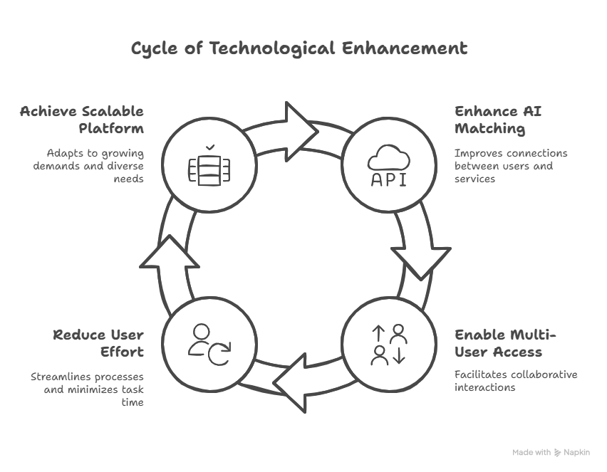

Slide 4

Traditional Solution vs.
Proposed Solution
Need for the Project
Impact on Community
Manual matching is inefficient for the volume of missing persons and media data.
Faster and wider reach for missing persons identification.
Empowers communities to actively participate in reporting and locating individuals.
Existing systems lack AI integration and user-friendly public reporting.

Slide 5
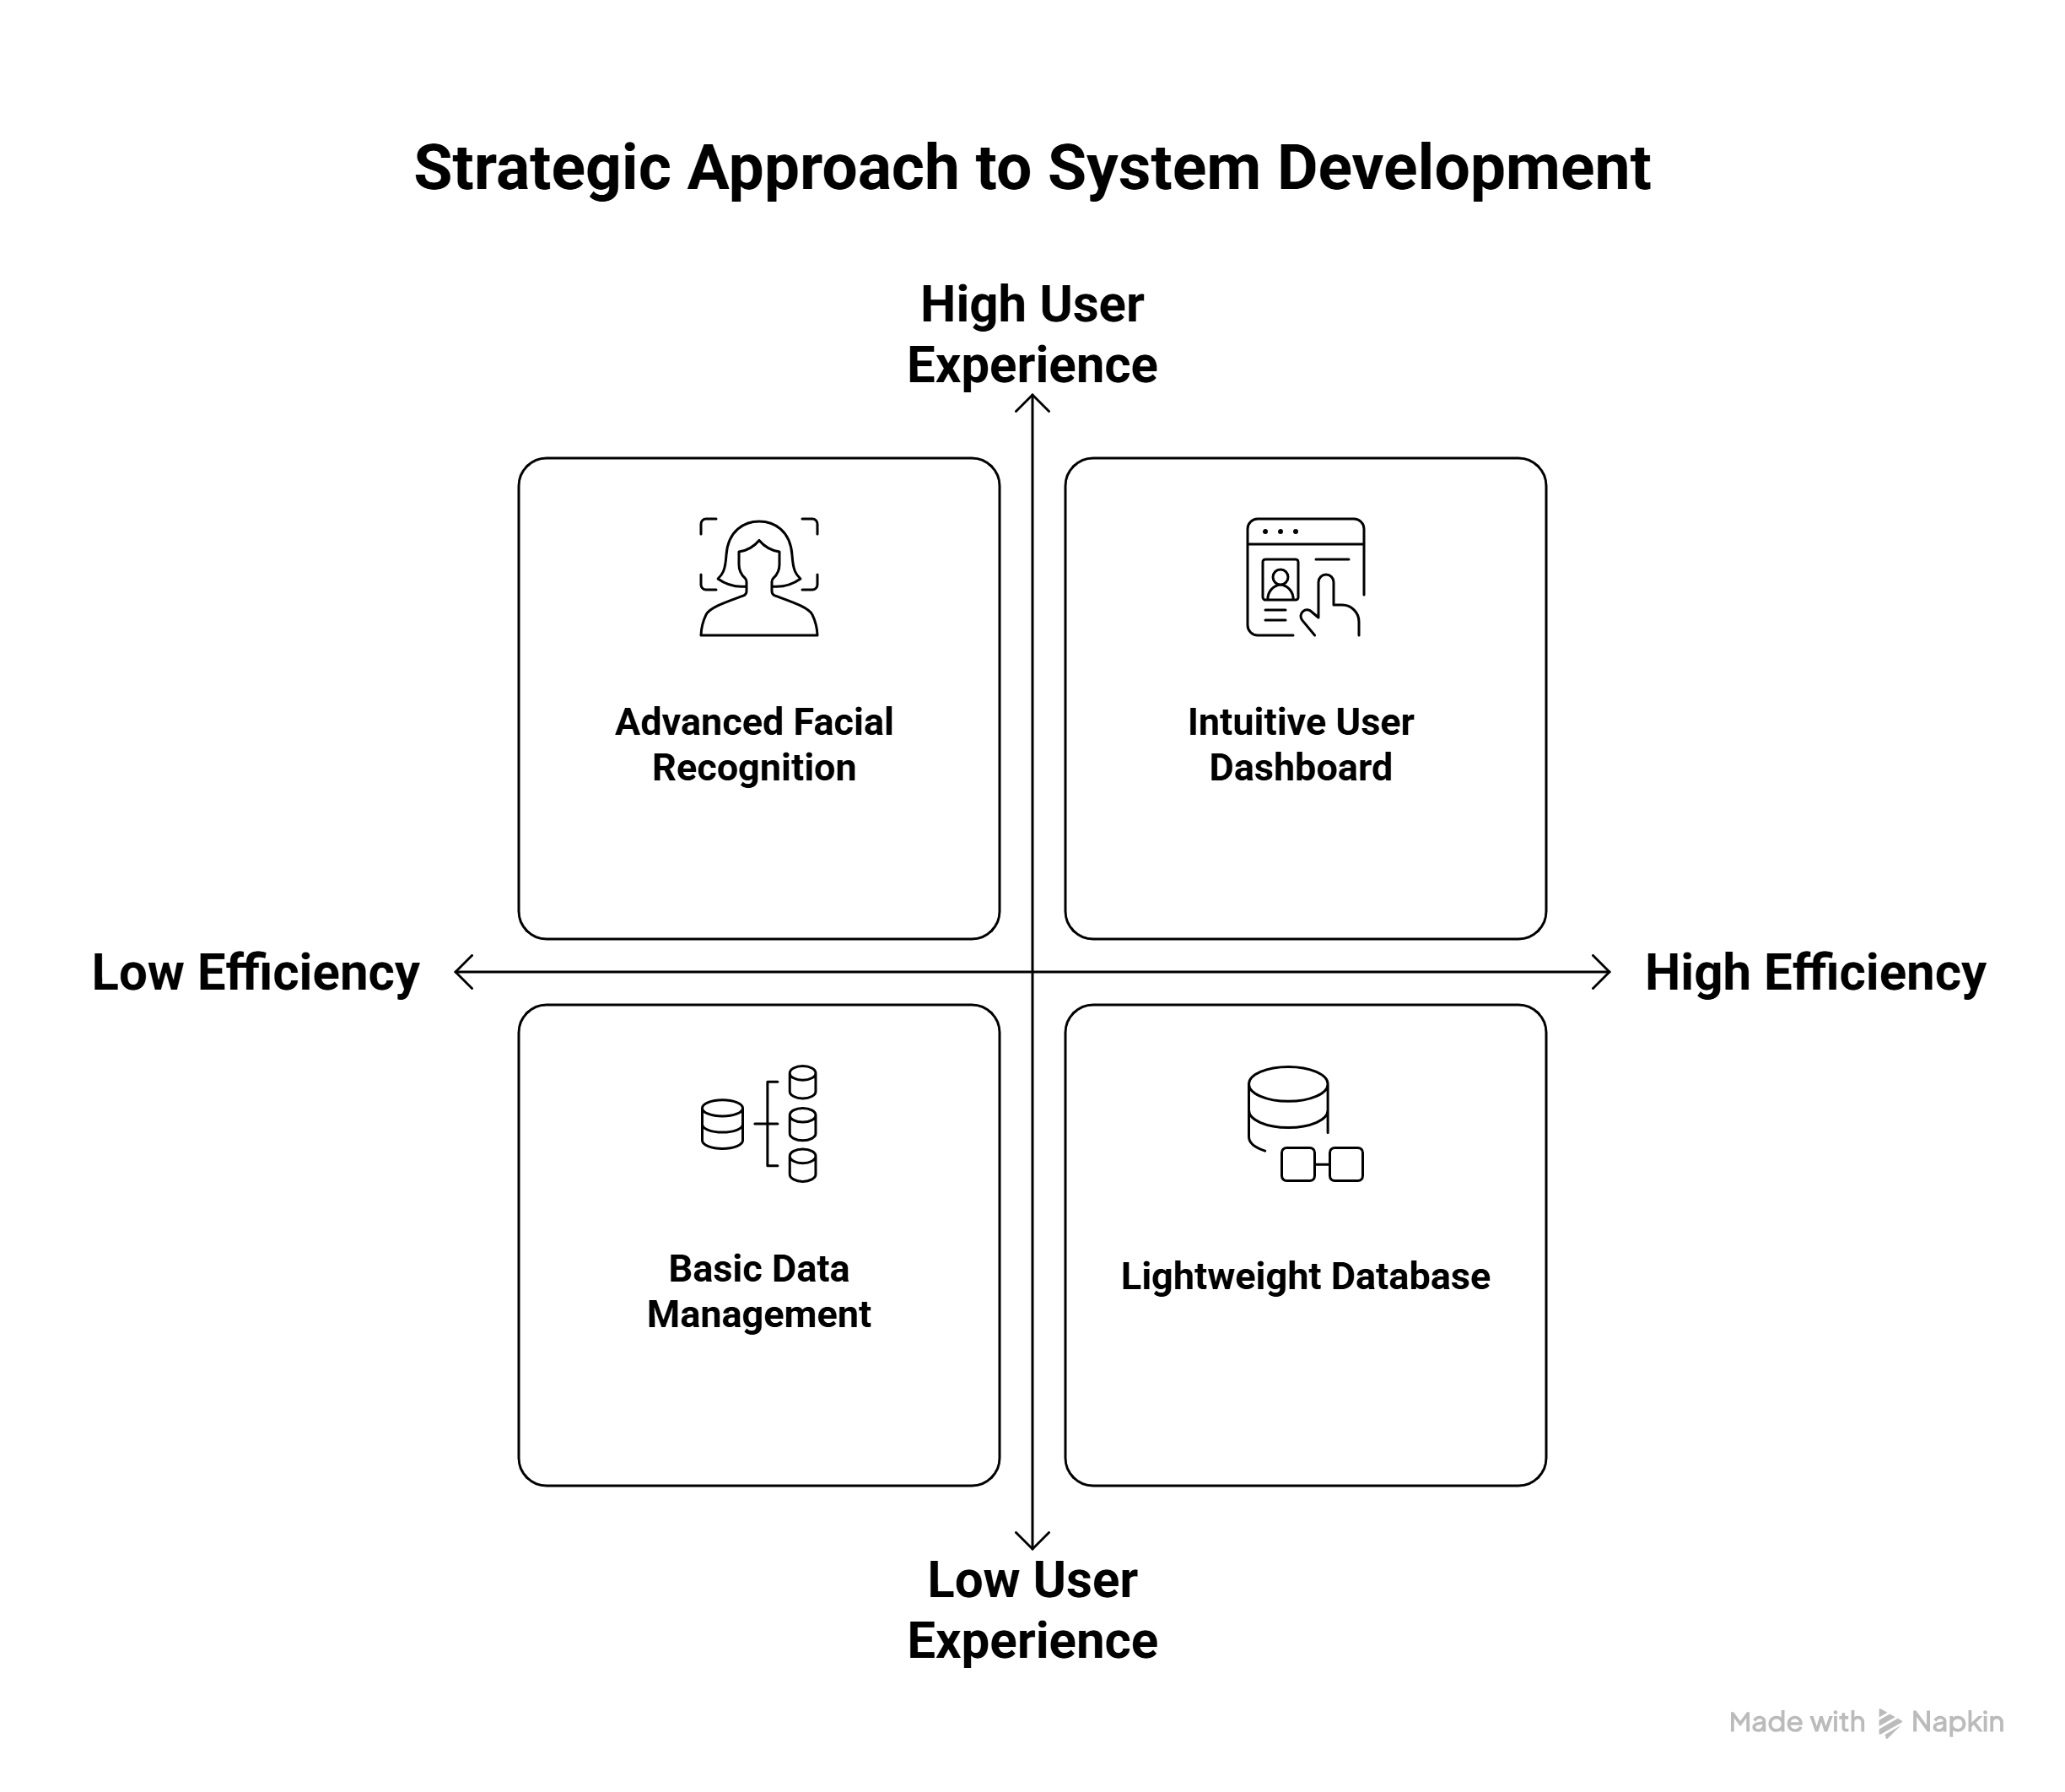

Slide 6




Tech Stack
Python
Streamlit
Core programming language for application development.
Framework for building interactive web applications.
MediaPipe
SQLite
AI model for real-time facial mesh detection.
Lightweight, file-based database for easy deployment.

Slide 7
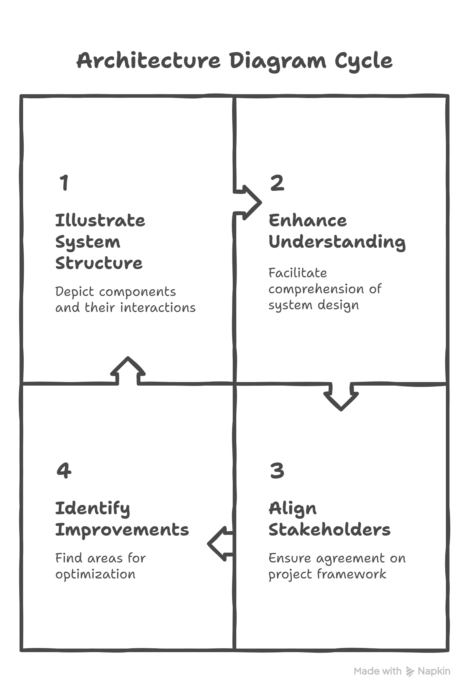

Slide 8





Snapshots of Our Prototype

Slide 9
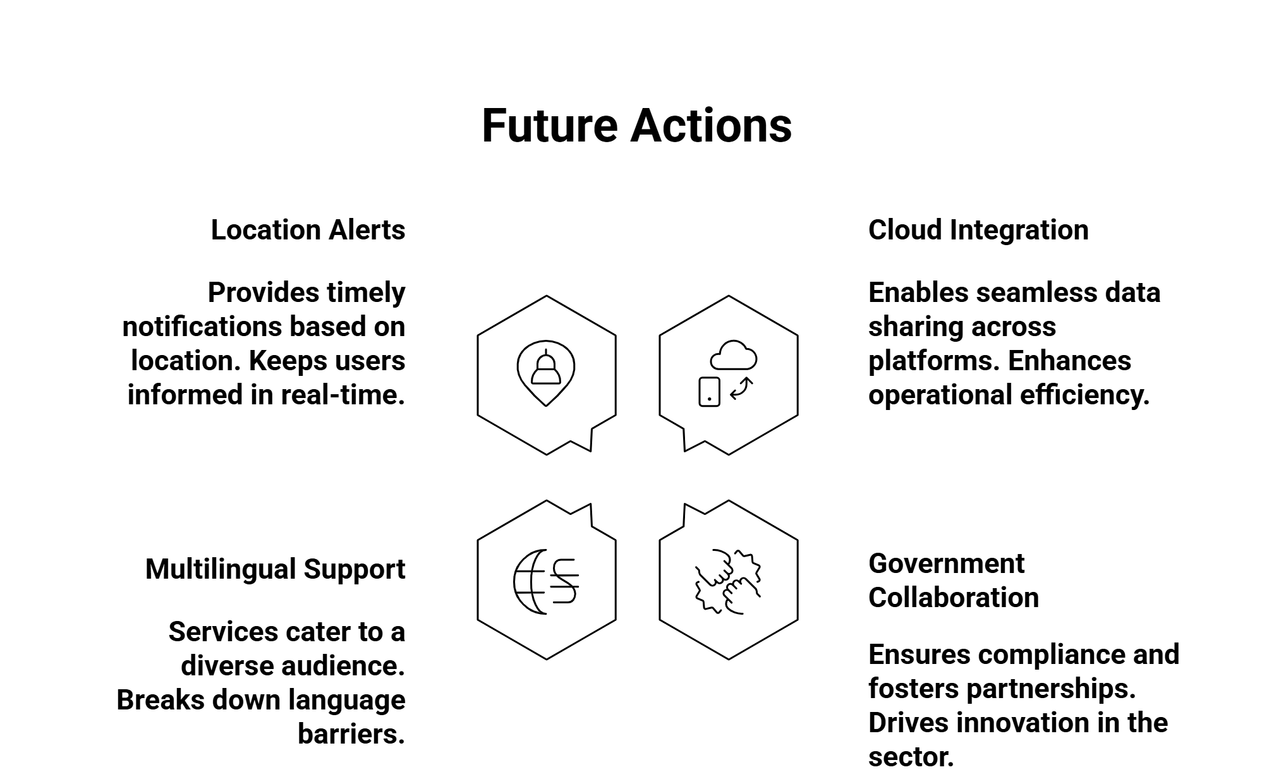

Slide 10

Social Impact
This project aims to significantly reduce the time and effort in finding missing persons, bringing hope to families and empowering communities. By leveraging AI, we can create a safer and more responsive society for everyone.

Slide 11
Thank
You

